Slide 1
ESC101 Introduction to Computing WELCOME
Amey Karkare
Dept of CSE
IIT Kanpur

Slide 2
Acknowledgements
All previous instructors of Esc101 at IIT Kanpur.
MS Office clip art, various websites and images
The images/contents are used for teaching purpose and for fun. The copyright remains with the original creator. If you suspect a copyright violation, bring it to my notice and I will remove that image/content.

Slide 3
The Course
The course teaches you how to solve problems using the computer.
No prior exposure to programming is needed.

Slide 4

What is a Computer?
Almost all electronic gadgets today are Computers.
They are everywhere!

Slide 5


Why am I doing this course?
Every discipline uses computing: All branches of engineering, sciences, design and arts.
Understand how computers work
Write your own programs
boring repetitive stuff!
Automate

Slide 6
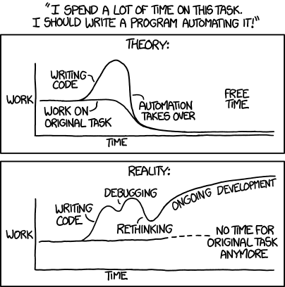
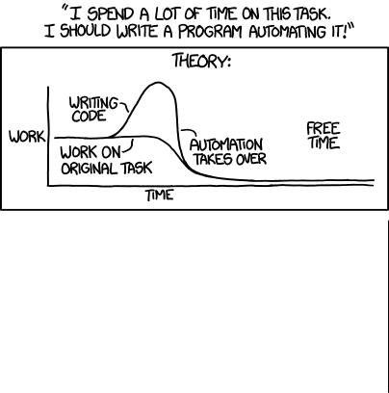
Source: http://xkcd.com/1319

Slide 7
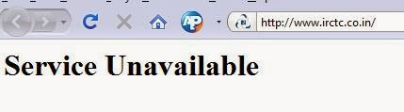
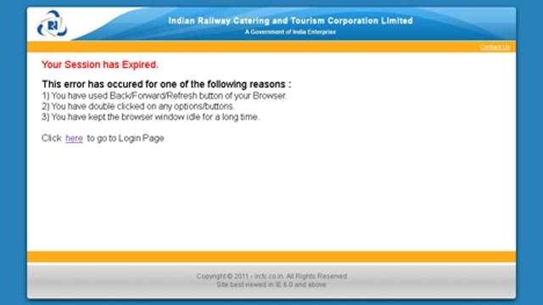
Process of Programming: Step 1
Define and model the problem. In real-life this is important and complicated.
For example, consider modeling the Indian Railways reservation system.

Slide 8
Process of Programming
In this course, all problems will be defined precisely and will be simple

Slide 9
Process of Programming: Step 2
Obtain a logical solution to your problem.
A logical solution is a finite and clear step-by-step procedure to solve your problem.
Also called an Algorithm.
We can visualize this using a Flowchart.
Very important step in the programming process.

Slide 10
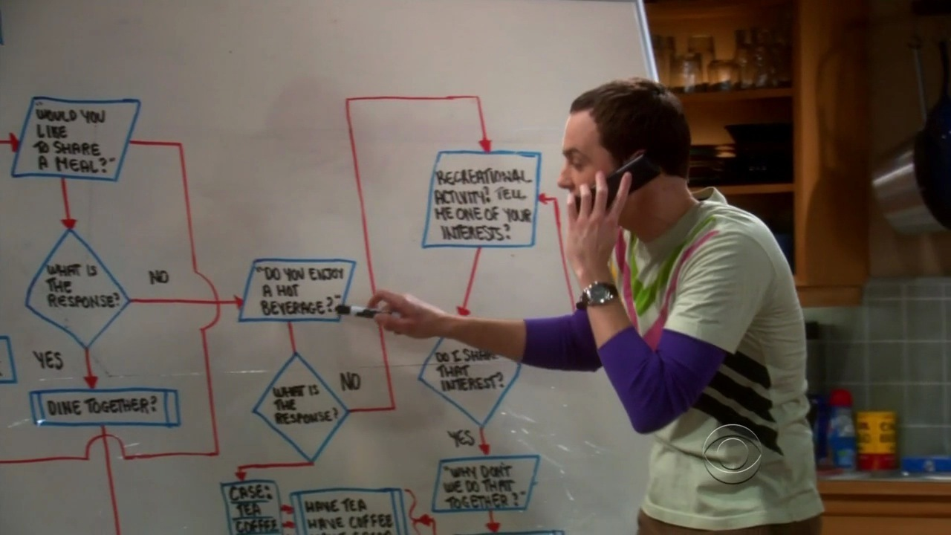
Friendship Algorithm/Flowchart
Source: The Big Bang Theory

Slide 11
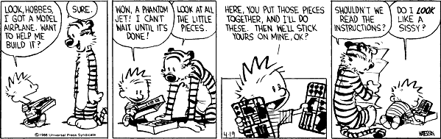
Algorithms in real-life
Any step-by-step guide. e.g. Assembly instructions for a make-it-yourself kit.
http://www.gocomics.com/calvinandhobbes/2009/06/02

Slide 12
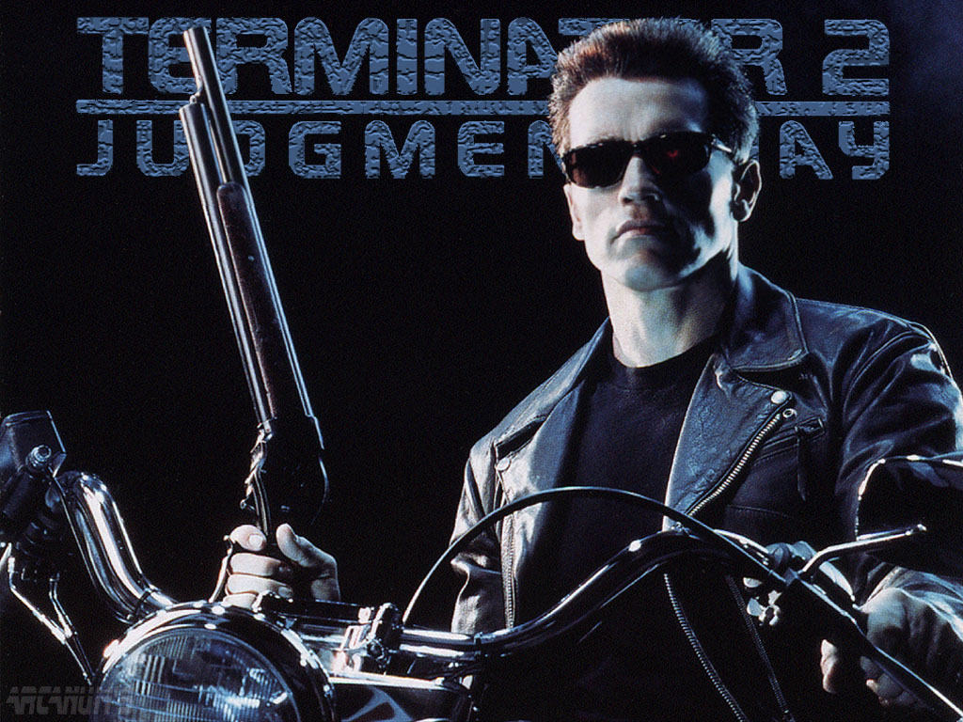
What is “NOT” a computer
At least for this course…

Slide 13
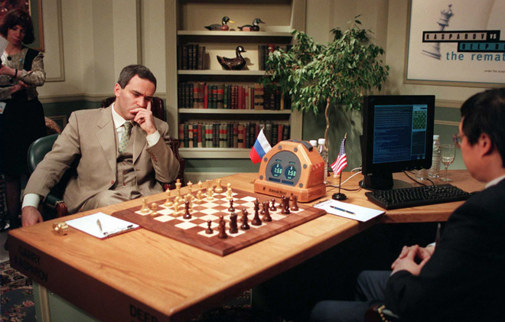
Some famous Computers
IBM Deep Blue

Slide 14
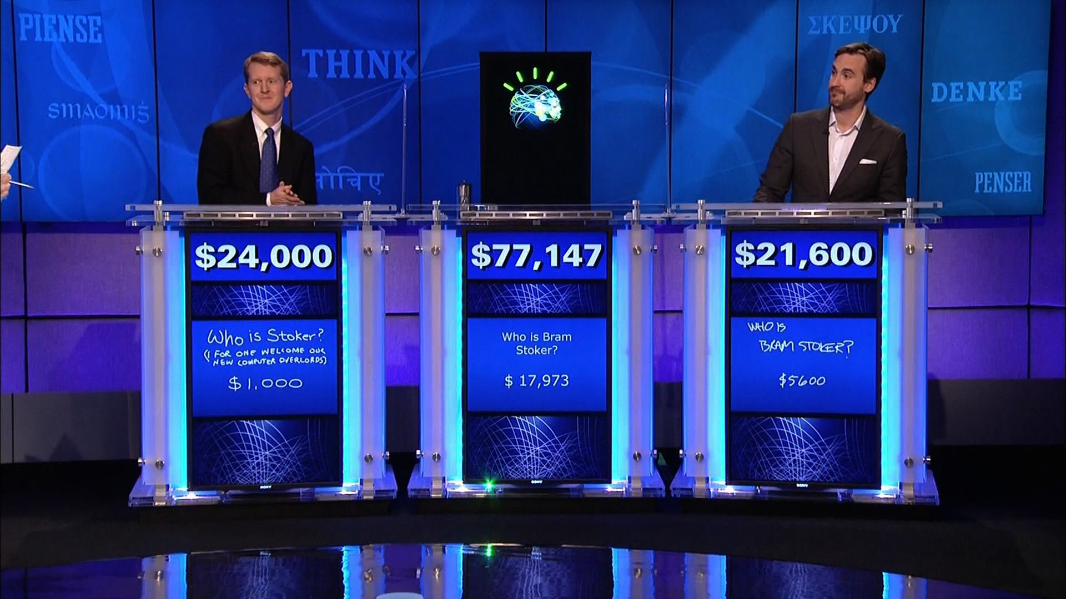
Some famous Computers
IBM Watson

Slide 15
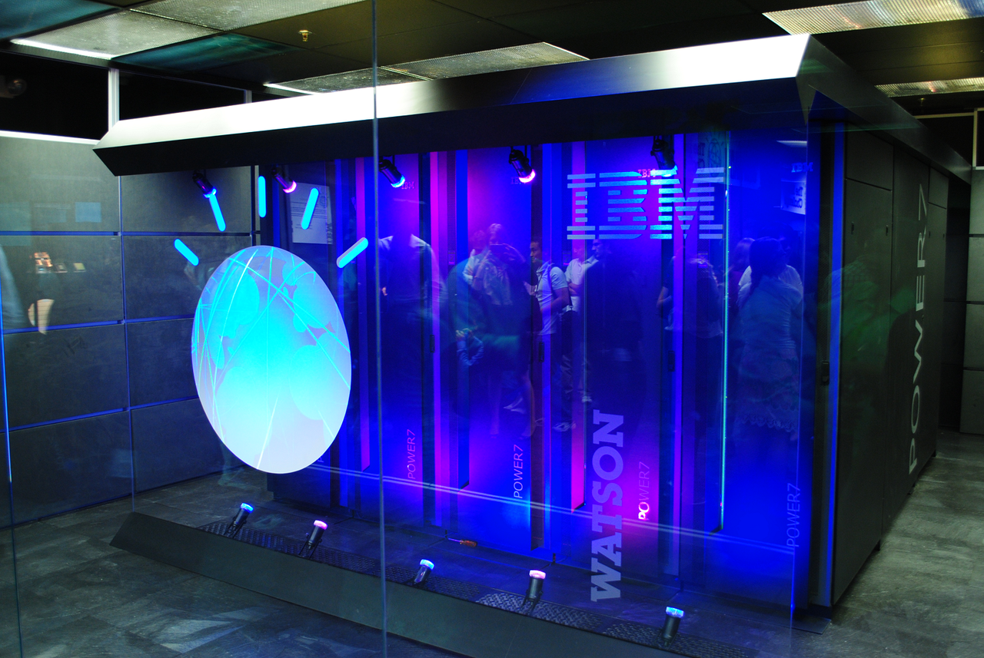
Some famous Computers
IBM Watson

